Slide 1
JIBEBE PROJECT
ELECTRICAL TEAM
EUNICE ORENGE
LABAN MWANGI
STEPHEN KINUTHIA
VICTOR NGATIA

Slide 2


OBJECTIVES FOR THE WEEK
Updating the controller parameters using its software
Integrate the display with the controller
Install the controller, battery and motor into the tractor
Working on the buck converter
.

Slide 3
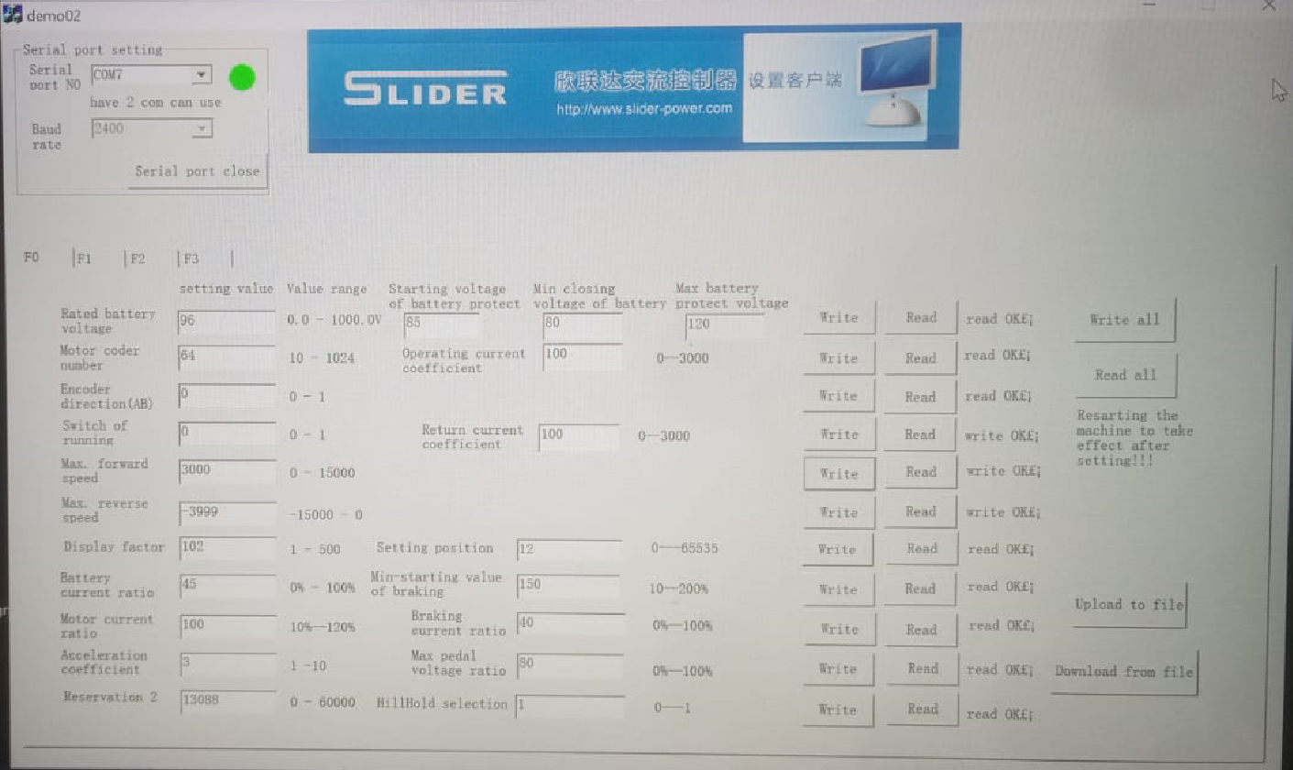
1. Updating the controller parameters using its software

Slide 4
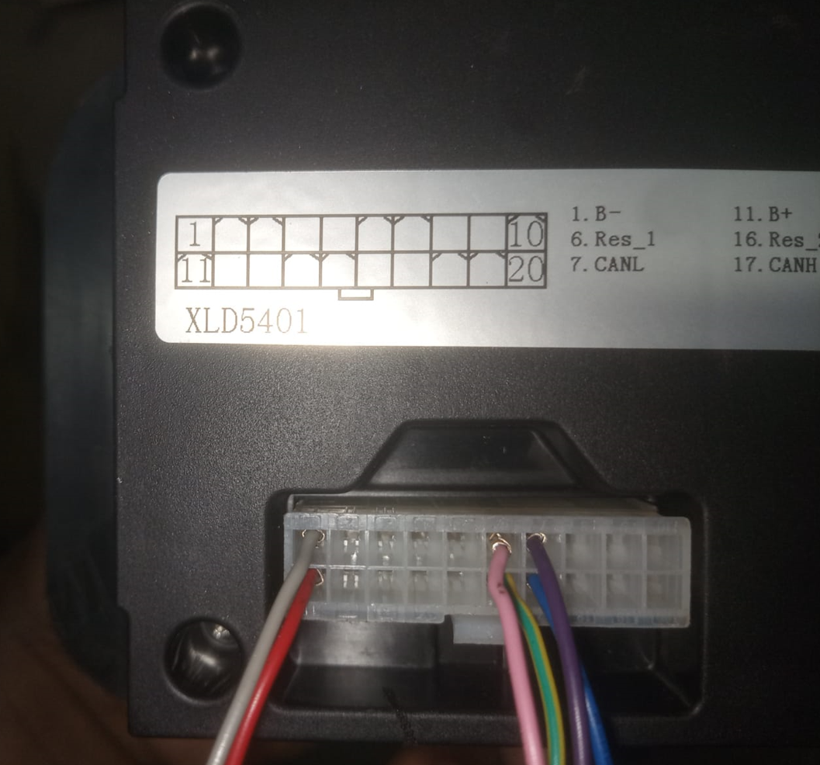
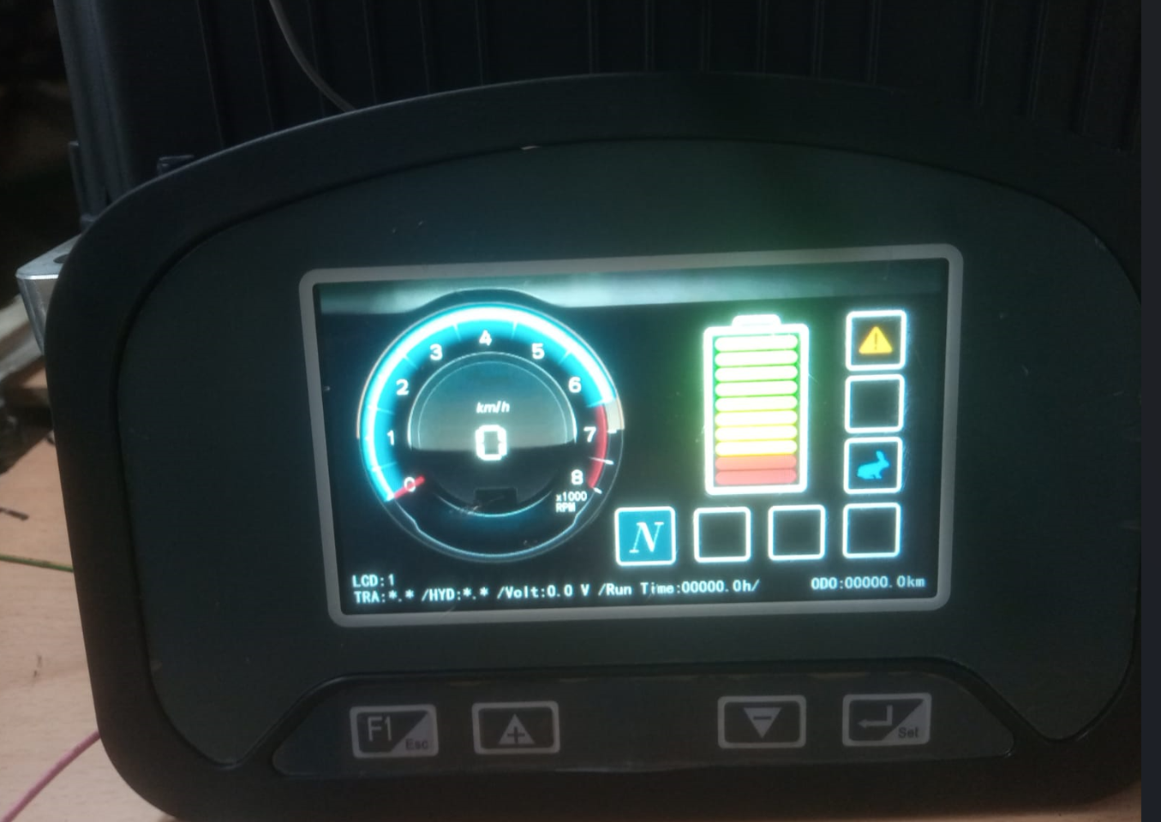
2. Integrate the display with the controller

Slide 5
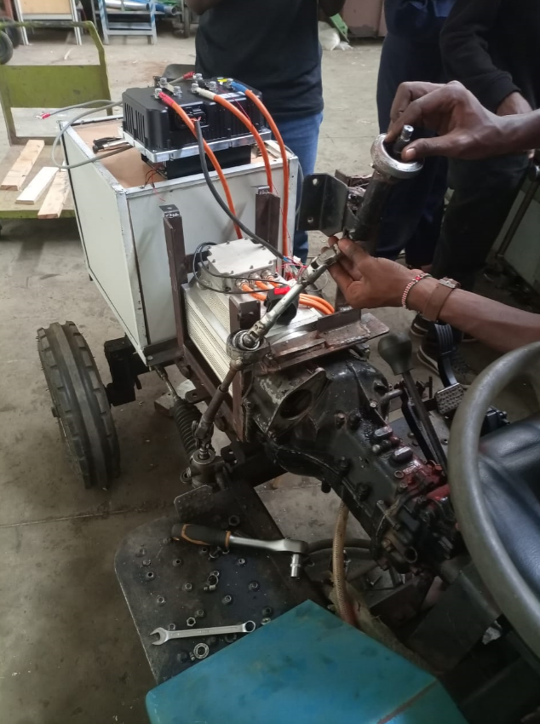
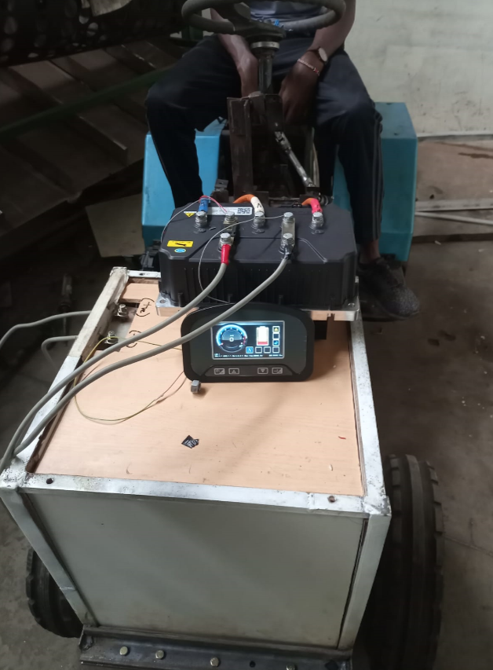
3. Mount the controller to the tractor

Slide 6
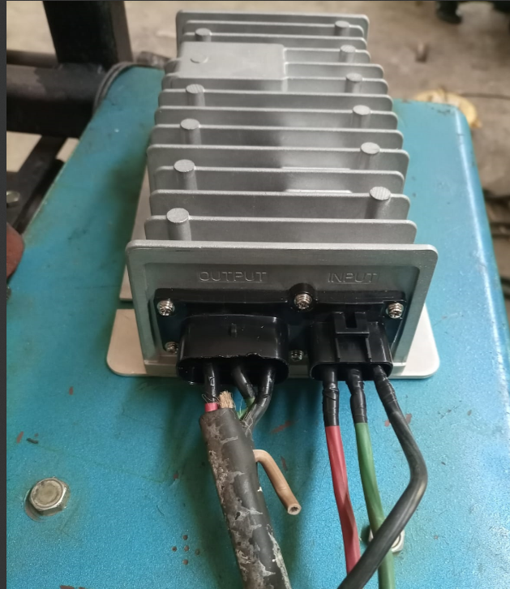
4. Working on the buck converter
We tried contacting the electrical engineers from Kiri but they were not of much help. We therefore, with the help of Mr Kanja, improvised a suitable connection for the buck converter

Slide 7
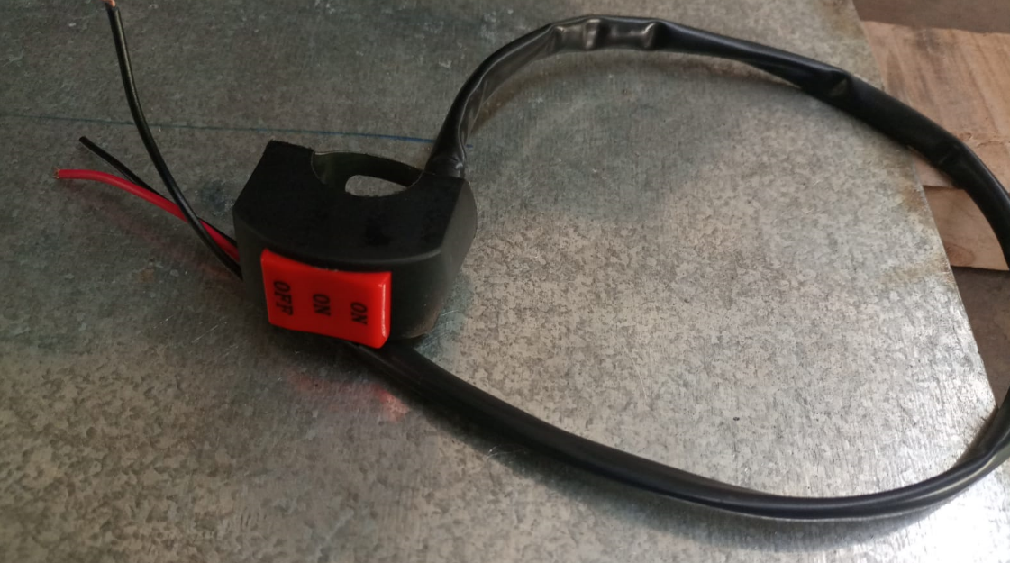
On testing the tractor, we realized that the gearbox did not provide reverse motion on changing the gear. This problem was solved by using the reverse feature provided by the controller. To make it easier to switch from forward to reverse, we purchase a switch that had two on modes.

Slide 8

OBJECTIVES FOR THE WEEK
Mount the charging system and the buck converter onto the tractor
Test the buck converter
Make neater connections
Install a switch for the forward and reverse motion of the tractor

